Slide 1

Image processing with Labview

Slide 2
Functions of application (front panel)
Sliders to reduce over bright Highlights and Shadows
Button to auto-balance highlights and shadows at the same time
Sliders to adjust hue of image in Red Green Blue channels
File Open selection and Save As
Zoom function to adjust image to canvas size
Real-time preview generation

Slide 3
Build theory and strategies (block diagram)
Unbundle image data into RGB channel data for manipulation and Re-bundle data for image preview and saving
Array search for desired values using For loops
Data isolation using greater-than/less-than and Boolean arrays
Whole array math operations for efficiency
Sequential flow from most to least impactful program functions

Slide 4
Solutions
Build difficulties
Addition/Subtraction effects all values of array even zeros
Logical flow makes sense but data type error
One For loop comparison does not let mid values remain unchanged
Not all images are the same dimensions. No data left out?
Images don’t fit canvas
Boolean array not outputting as expected
Does not update image preview
Keeps trying to open/save file
Re-bundle doesn’t output right data type for image preview
No image file I/O functions to be found
Heavy color banding and distortion with big value changes
Use of multipliers to perform operation only on desired data
Data type convertors and representation settings
Split into two For loops with one greater-than one less-than value
Wire For loop iterator to Array size function so will always get all data
Zoom factor property node control
Change from Shift Register to Tunneling
While loop around whole program
Put open/save outside while loop
Wire original image data to input on top of Bundle so it knows type of data
Search Bar in functions for Graphics & Sound folder
Reduce range of controls, add color control

Slide 5
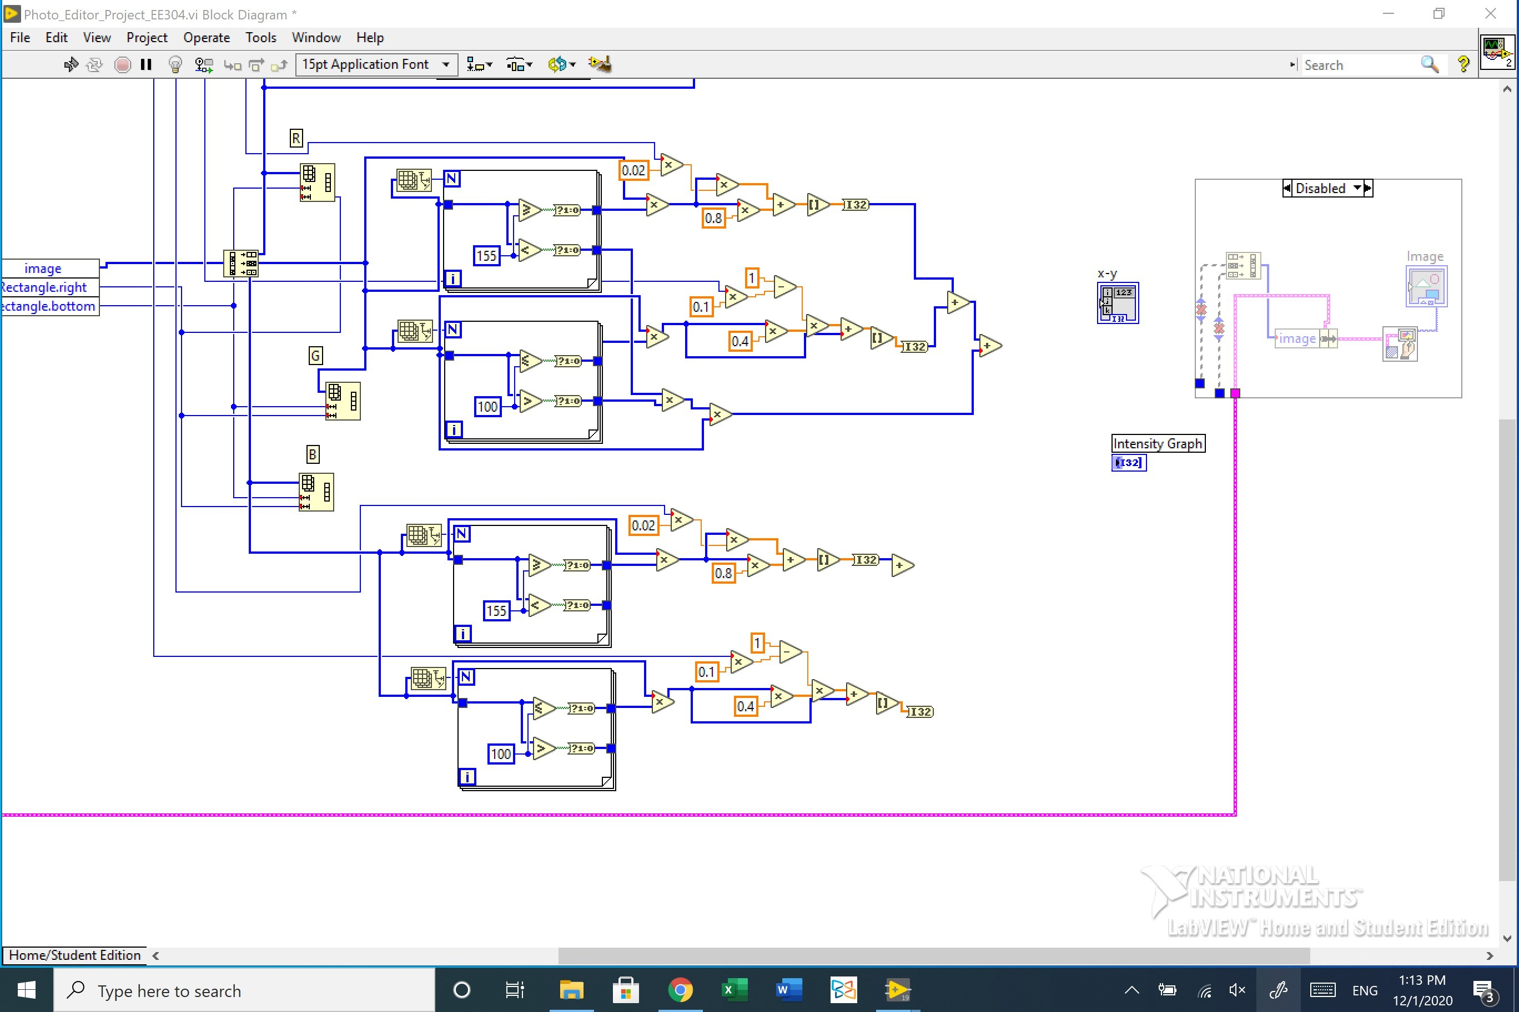
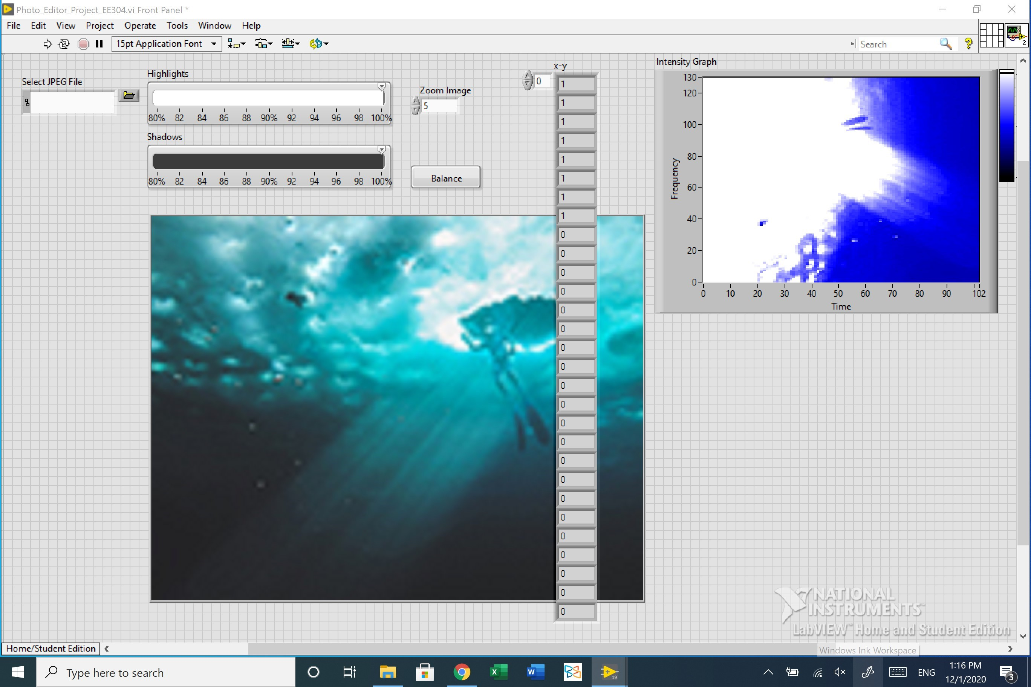
Other In Development strategies
Use of Diagram Disable Structure
Use of impermanent array indicators to verify output function
Use of Reshape Array to generate R, G, or B only equivalent image arrays
Intensity Graph indicator to assure output behaves as expected visually

Slide 6
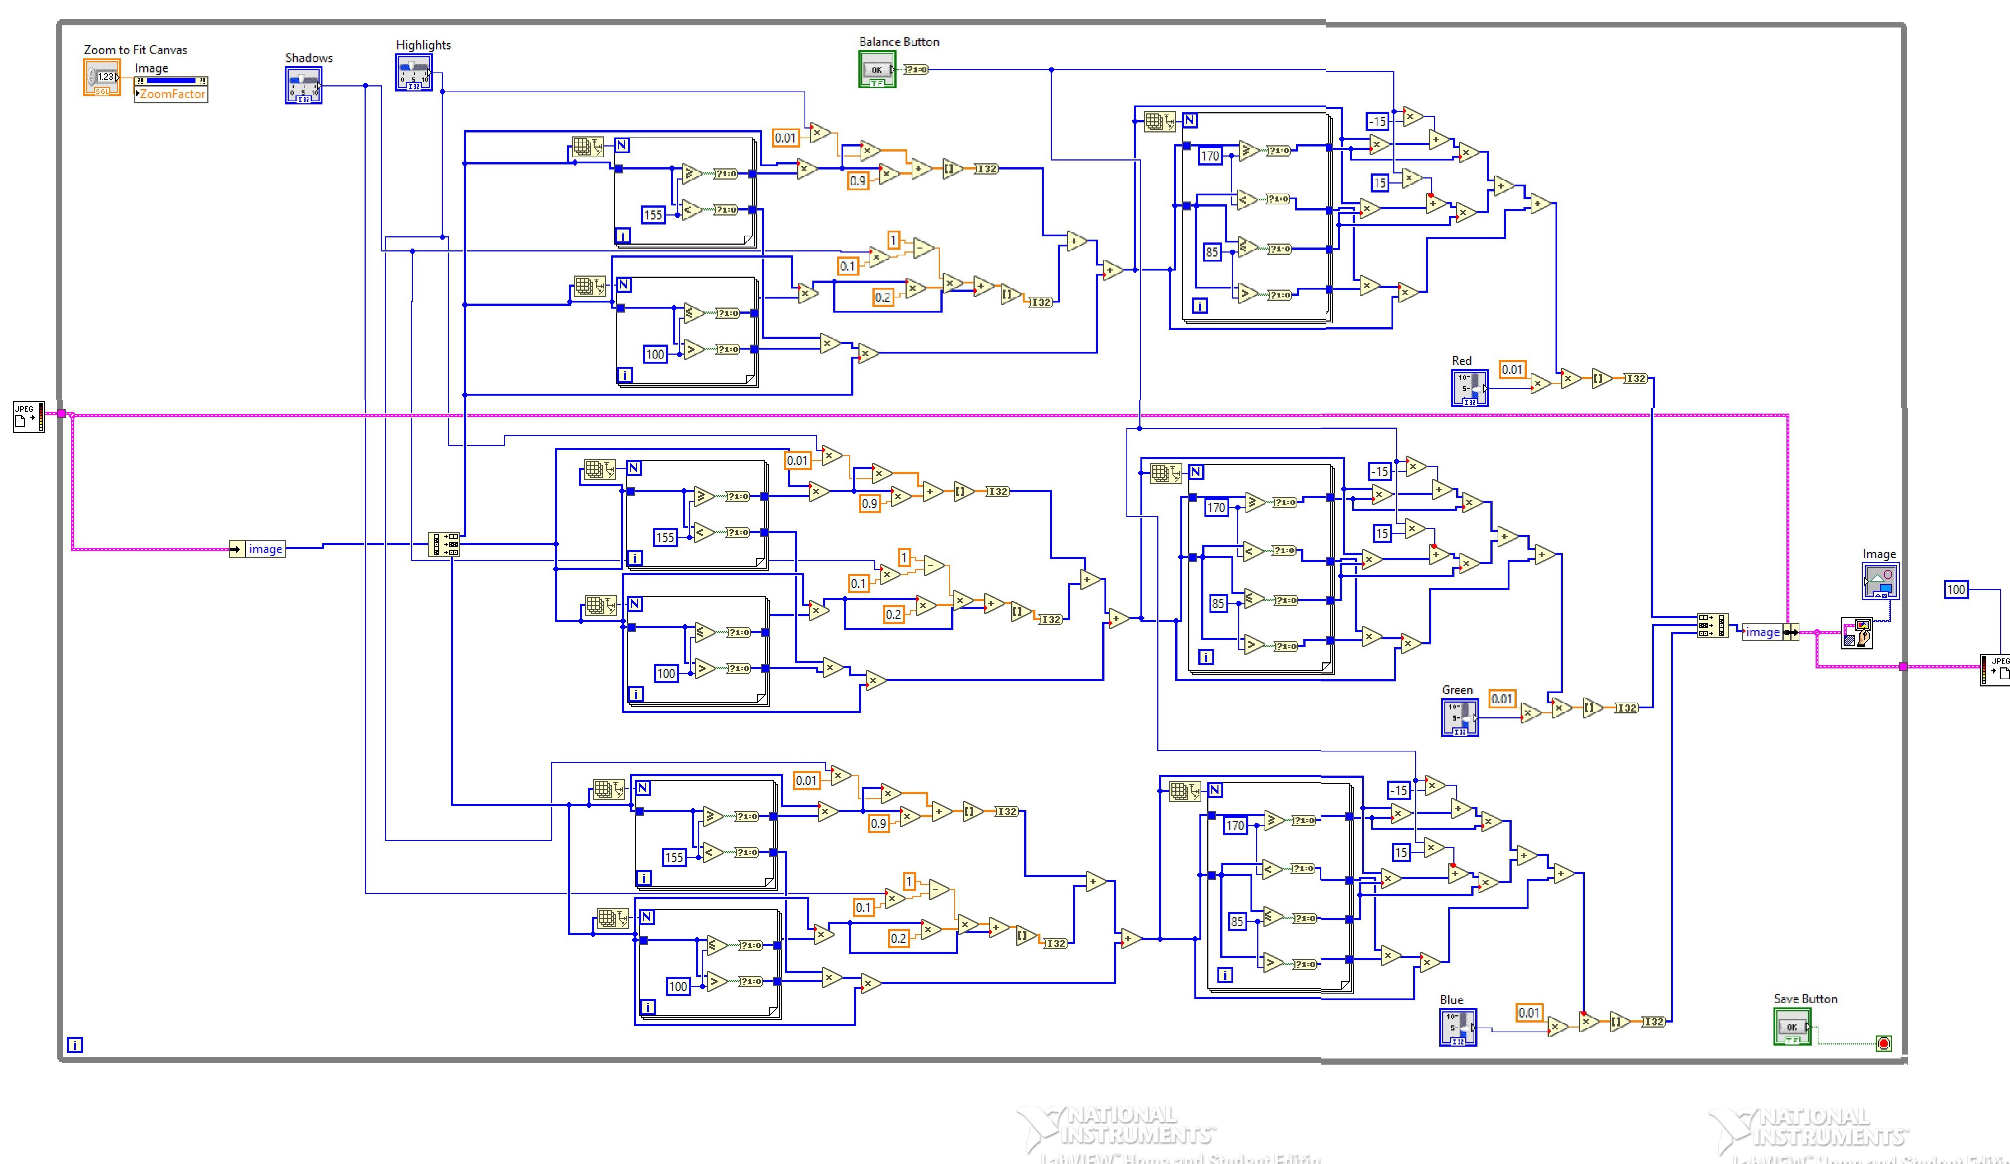
Main program block diagram

Slide 7
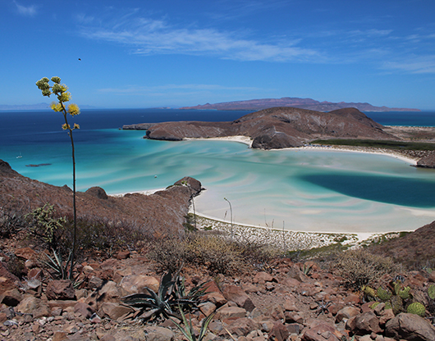
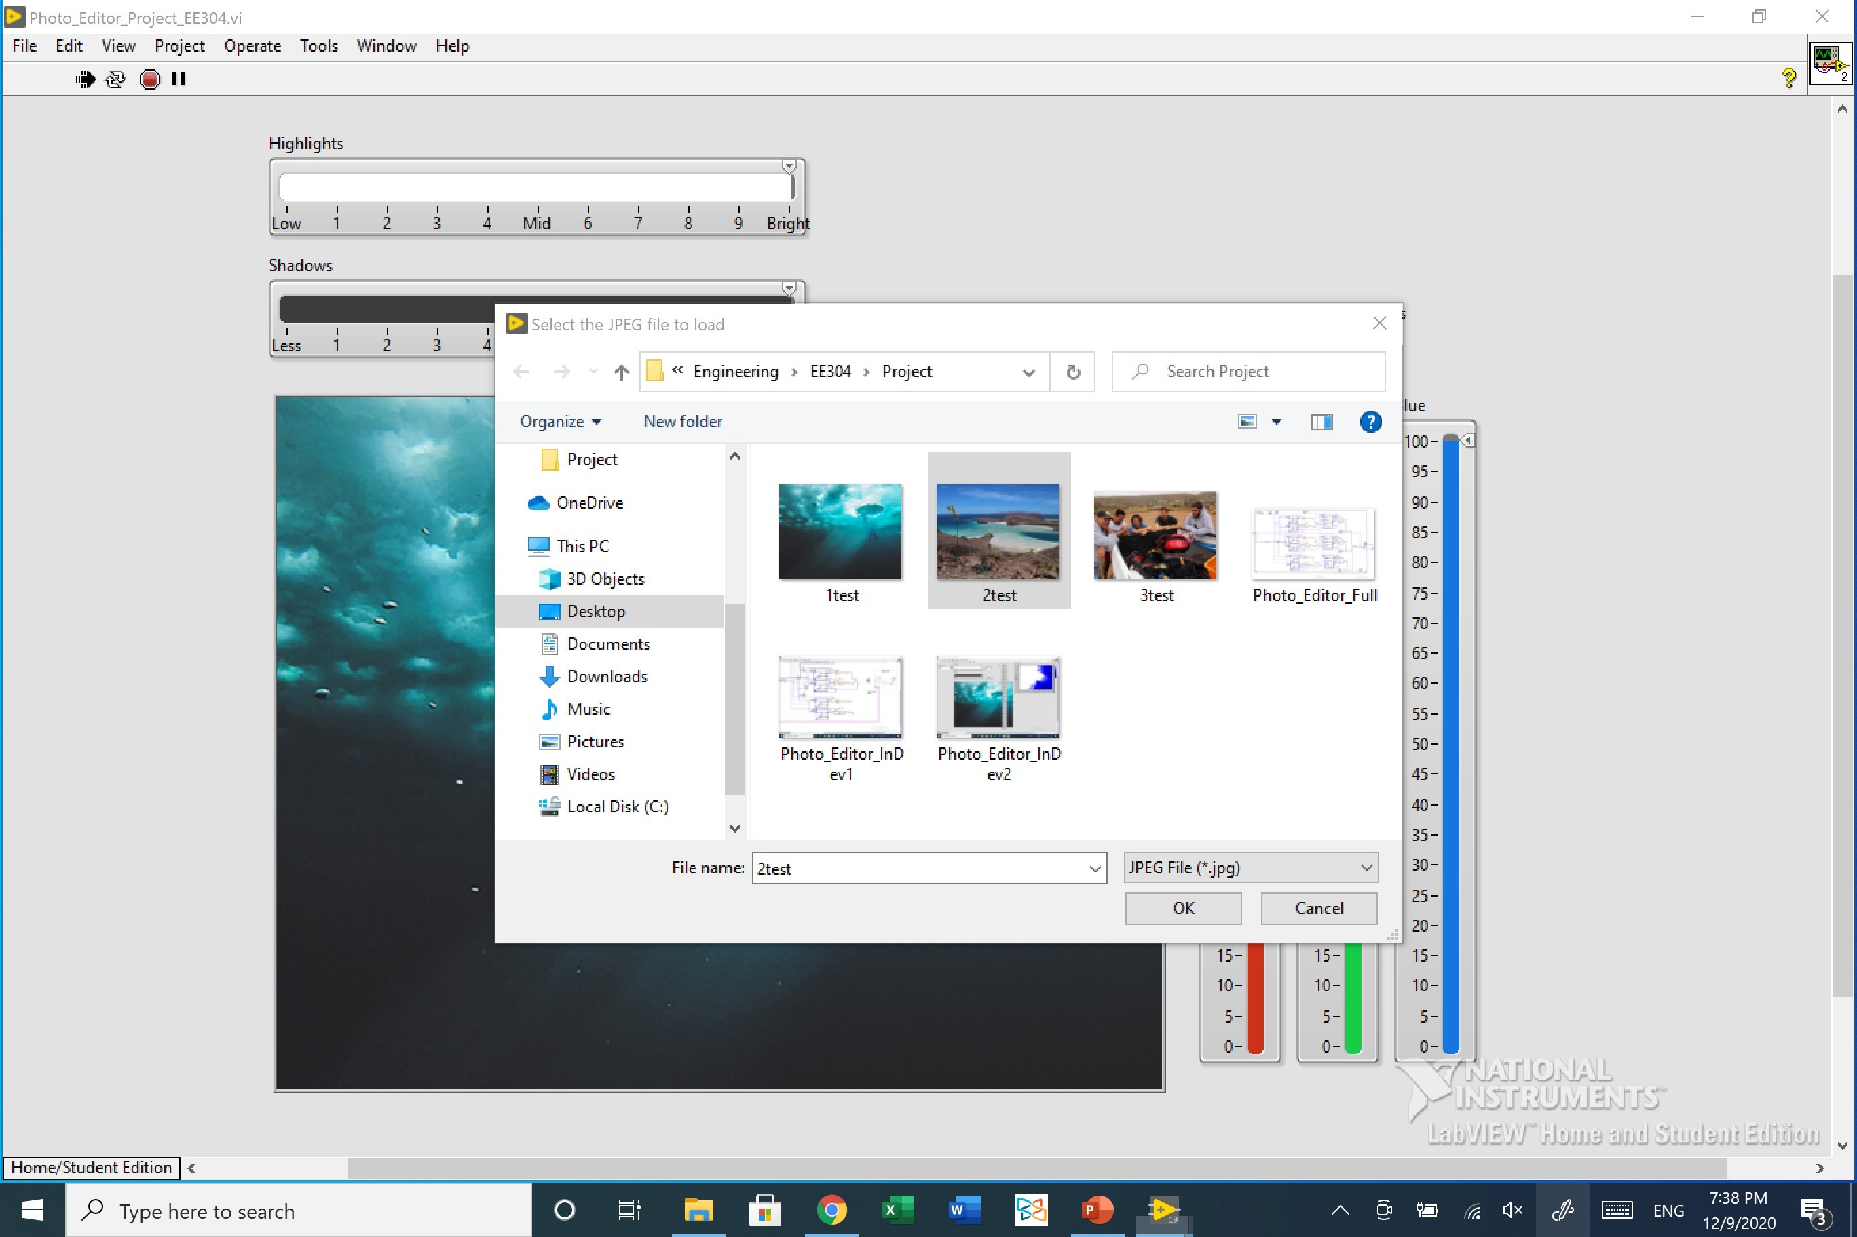
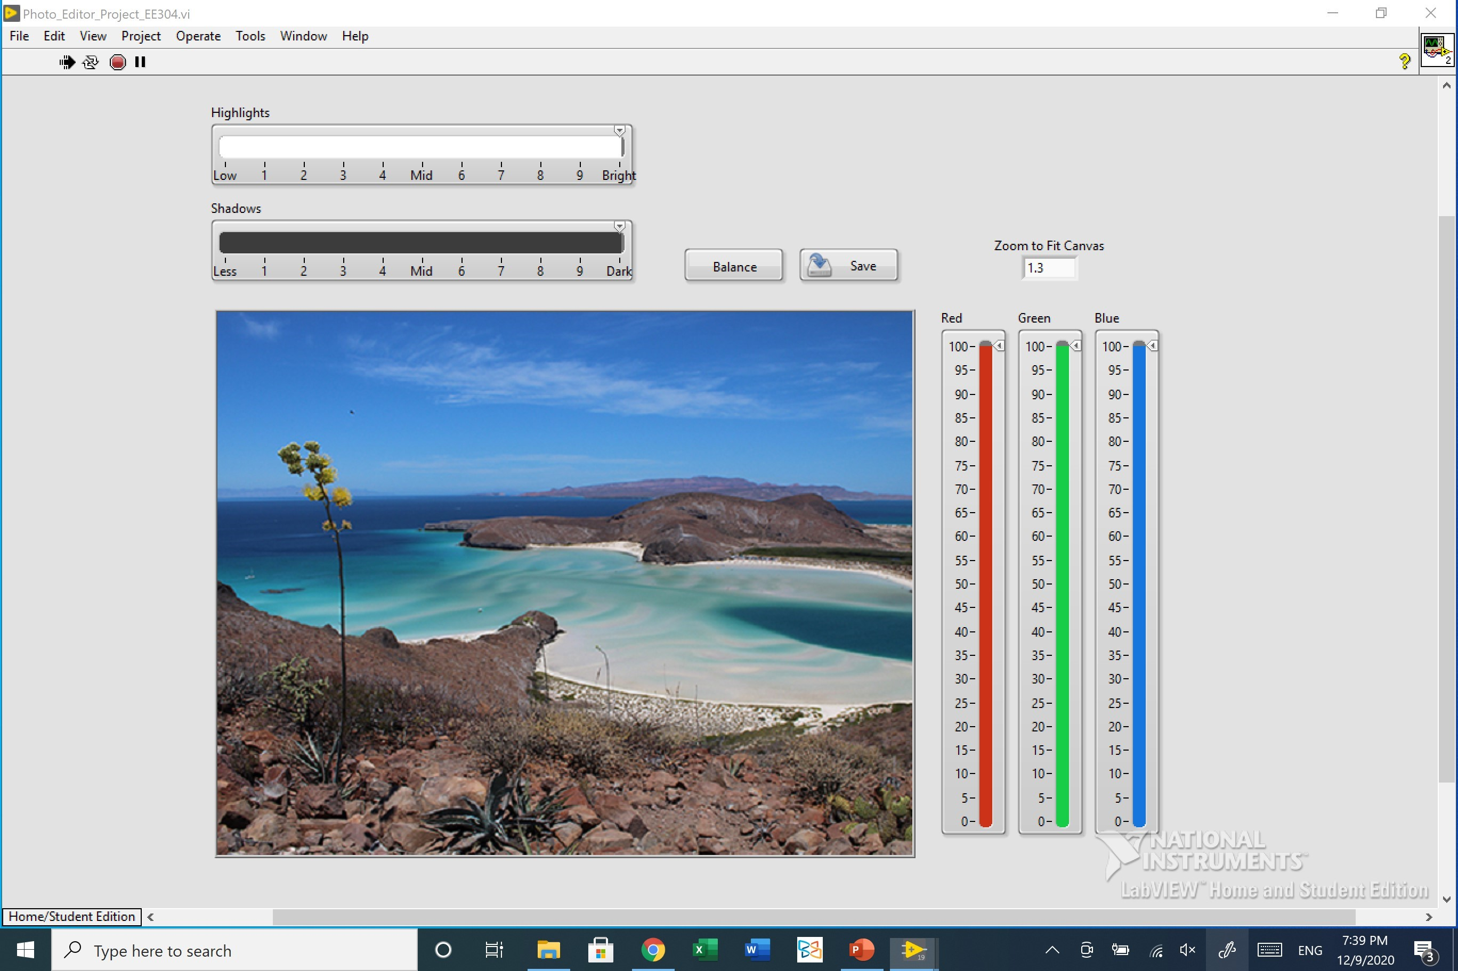
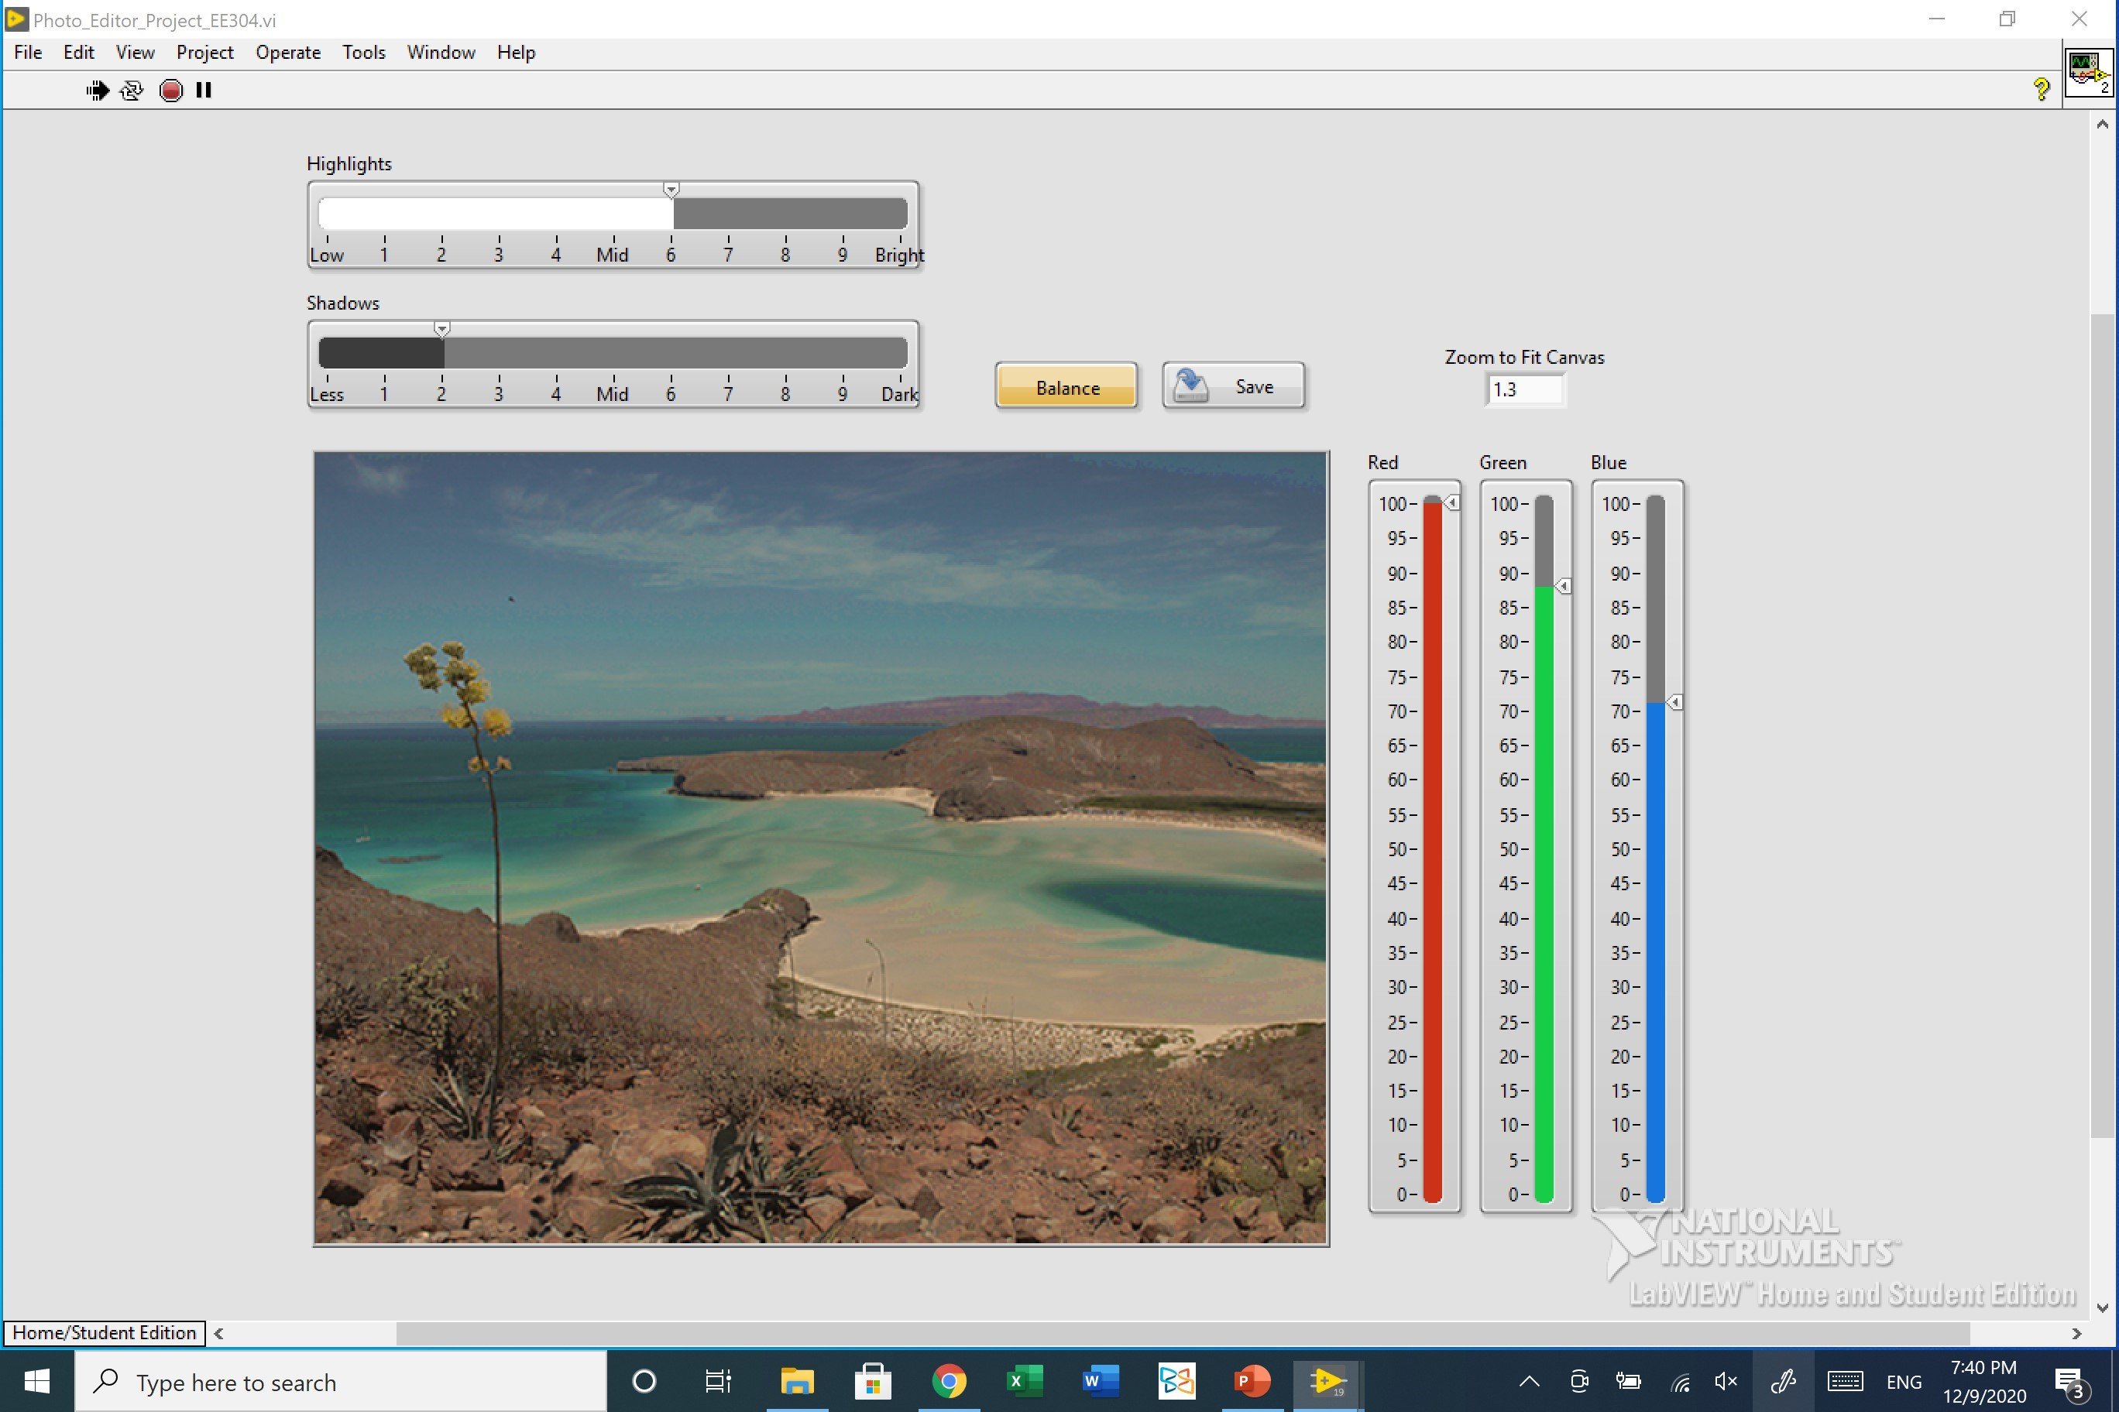
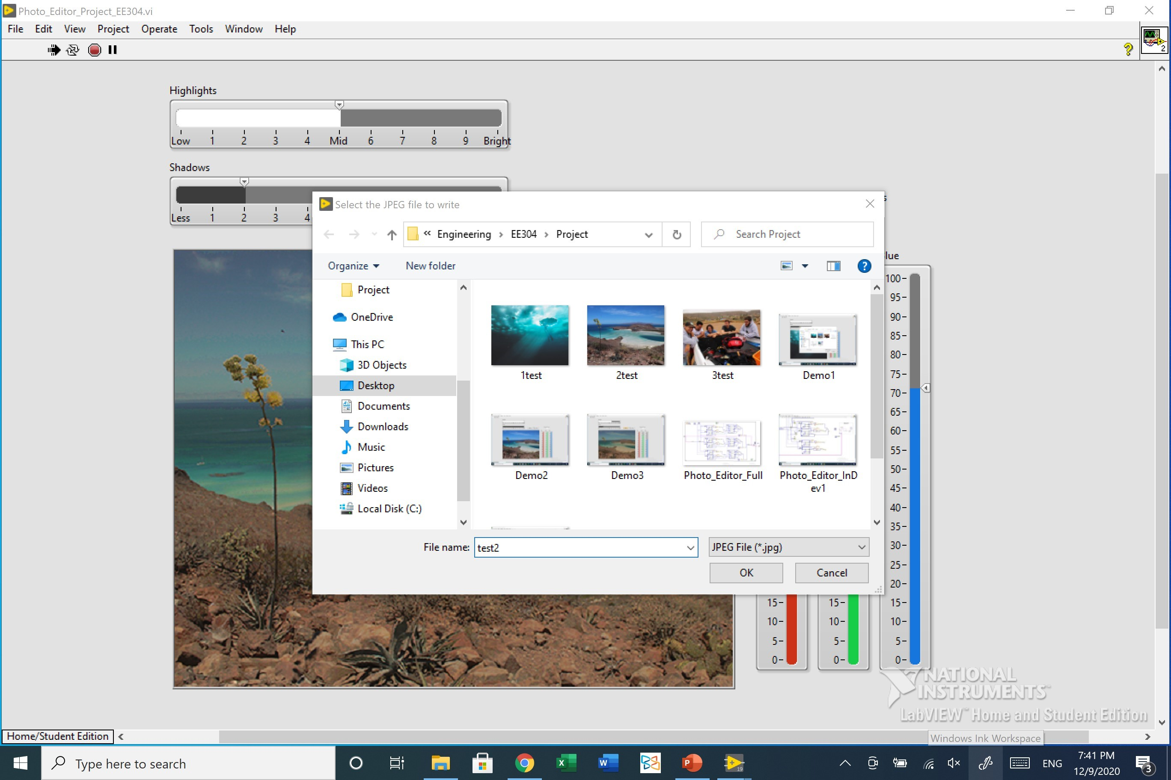
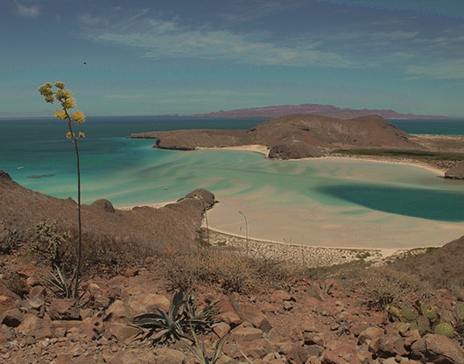
Demo Run Screenshots
Video Demo Link: https://www.youtube.com/watch?v=9zNX6LIqJqY&feature=youtu.be

